Slide 1

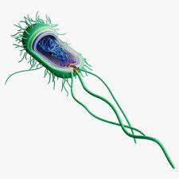
Microbial Genetics:
Gene Structure, Replication and Expression
Jheyrick C. Baliguat
BS Biology 4

Slide 2


An Overview
Why it is important to study Microbial genetics?
01
Understanding Fundamental Biological Processes
02
Applications in Medicine
Microbial Genetics in several fields
03
Biotechnology and Genetic Engineering
03
Research and Critical Thinking Skills

Slide 3
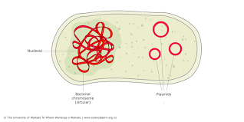
Genetics terminology
Microbial Genetics
Gene Expression
the study of the mechanisms of heritable information in microorganisms, including bacteria, archaea, viruses and some protozoa and fungi.
The process by which the information in a gene is used to produce a functional gene product, typically a protein.
Genome
Gene
the entire set of DNA instructions found in a cell
A segment of DNA that contains the instructions for synthesizing a specific protein or RNA molecule.
Horizontal Gene Transfer (HGT)
Chromosomes
The transfer of genetic material between organisms in the same generation, which can occur through transformation, transduction, or conjugation.
A physical structure composed of DNA and proteins that carries genetic information
Notes:
Because of Binary fission and the present of two sets of DNA this leads to irregularity some bacterium does not posses plasmid that is why it needs to be copied in microbes
Transformation: This involves the uptake of free DNA from the environment by a bacterial cell. The DNA may come from lysed cells or be deliberately released into the environment. If the incoming DNA is compatible with the host genome, it can integrate into the host’s DNA, leading to genetic changes.
Conjugation: This process requires direct cell-to-cell contact. It involves the transfer of plasmids (small, circular DNA molecules) from one bacterium to another through a structure called a pilus. Conjugation can transfer genes that confer antibiotic resistance or other beneficial traits, enabling rapid adaptation to changing environments.
Transduction: In this mechanism, genetic material is transferred between bacteria via bacteriophages (viruses that infect bacteria). During infection, a bacteriophage may mistakenly incorporate a fragment of the host DNA into its viral genome. When it infects a new host, it can transfer that DNA fragment, leading to genetic variation in the recipient cell.
Importance of Horizontal Gene Transfer

Slide 4
Genetics terminology
Plasmids
A small, circular piece of DNA found in bacteria that can replicate independently and often carries genes beneficial for survival.
Transcription
The process of copying a segment of DNA into RNA, specifically mRNA, which will be translated into a protein.
Translation
The process by which ribosomes synthesize proteins using the information encoded in mRNA.
Notes:
So that is why Horizontal gene transfer because some microbes because of binary fission there is irregularity some microbes does not posses plasmid DNA

Slide 5
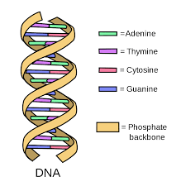
Gene Structure
Microbial DNA structure and Composition
Purines (Guanine & Adenine)
Pyrimidines (Thymine, Cytocine, & Uracil)
Notes:
This is the overview of the gene structure consisting of base pairs that are complementary and a sugar phosphate serves as a backbone of the structure

Slide 6
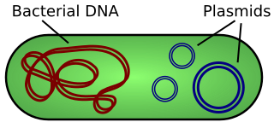
Prokaryotic Gene structure
Bacterial Genome consist of Chromosomal and plasmid DNA
MOST BACTERIA HAVE A HAPLOID GENOME, A SINGLE CHROMOSOME CONSISTING OF A CIRCULAR, DOUBLE STRANDED DNA MOLECULE. HOWEVER LINEAR CHROMOSOMES HAVE BEEN FOUND IN GRAM-POSITIVE BORRELIA AND STREPTOMYCES SPP., AND ONE LINEAR AND ONE CIRCULAR CHROMOSOME IS PRESENT IN THE GRAM-NEGATIVE BACTERIUM AGROBACTERIUM TUMEFACIENS.

Slide 7
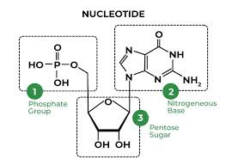
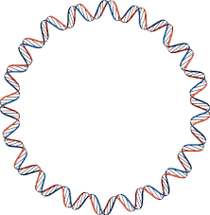



Gene Structure
DNA is consist of Nucleotides
Nucleotides consists of Phosphate groups Pentose sugars (Deoxyribose for DNA and Ribose for RNA, and Nitrogenous bases (Adenine, Thymine Cytosine, and Guanine)

Slide 8
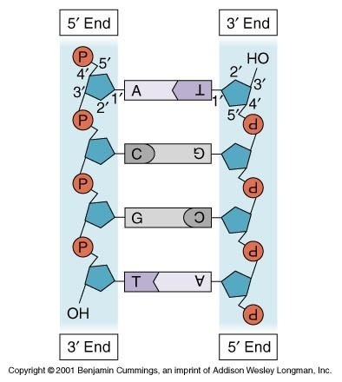
Gene Structure
Base pair has been held together by hydrogen bonds
Covalent bond connect the Phosphate to sugars and sugars into nitrogenous bases
DNA anti parallel
Although they never converge and diverge they are opposite to each other.
DNA replication is semiconseravative
Bases are complimentary
Notes:
Carbons in Pentose sugars marks the 5’ 3’ polarity leading the directional reading of DNA and RNA polymerase in replication and transcription
3’ attach to hydroxyl group and form a phosphodiester bond with the nucleotide while 5’ carbon attached to phosphate group

Slide 9
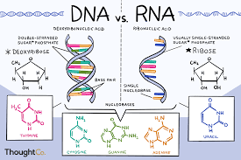
DNA vs RNA
Strand
Double strand vs Single strand
Sugar
Deoxyribose vs Ribose
Base
Thymine vs Uracil
Notes:
Difference between DNA and RNA first from double helix DNA has been synthesize by RNA polymerase into single strand RNA with complementary bases
FROM Deoxyribose pentose sugars has been transformed to ribose sugars thru hydroxylation
And for Nucleotide bases Uracil will be synthesized as complementary for adenine rather than thymine

Slide 10
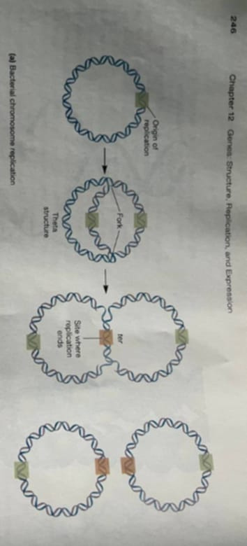
DNA Replication
the process by which a double-stranded DNA molecule is copied to produce two identical DNA molecules.
REPLICATION OVERVIEW
Replication patterns are somewhat different in Bacteria, Archaea, and eucaryotes. For example, when the circular DNA chromo- some of E. coli is copied, replication begins at a single point, the Replication Origin (oriC). Synthesis occurs at the replication fork, the place at which the DNA helix is unwound and individual strands are replicated. Two replication forks move outward from the origin until they have copied the whole replicon-the portion
Notes:
The DNA replication exhibits a high degree of fidelity.
The hydrogen bonding between G and C or A and T is much mores stable than between mismatched pairs.
Proofreading function the ability to remove mismatched bases.
The origin is named oriC (for origin of Chromosomal Replication).
There are three types of DNA sequences within oriC that are functionally important:
an AT-rich region,
DnaA box sequences, and
GATC methylation sites.

Slide 11
Components of Microbial DNA Replication Machinery
Protein | Functions
DNA A | Initiation of replication; binds origin of replication (oriC)
DNA B | Helicase (5' to 3'); breaks hydrogen bonds holding two strands of double helix together, promotes DNA primase activity; involved in primosome assembly daughter molecules in final stages of replication
DNA Gyrase | Relieves supercoiling of DNA produced as DNA strands are separated by helicases; separates daughter molecules in final stages of replication
DNA C protein | Bind single-stranded DNA after strands are separated by helicases
DNA primase | Synthesis of RNA primer, component of primosome
DNA polymerase III haloenzyme | Complex of about 20 polypeptides; catalyzes most of the DNA synthesis that occurs during DNA replication; has 3'5' exonuclease (proofreading) activity

Slide 12
Components of Microbial DNA Replication Machinery
Protein | Functions
DNA polymerase I | Removes RNA primers; fills gaps in DNA formed by removal of RNA primer
RIbonuclease H | Removes RNA primers
DNA Ligase | Seals nicked DNA, joining DNA fragments together
DNA replication terminus site-binding protein | Termination of replication
Topoisomerase | Segregation of chromosomes upon completion of DNA replication
Notes:
The enzymes known as DNA polymerases are responsible for covalently attaching nucleotides together to make new daughter strands.
In E. coli, there are five distinct proteins that function as DNA polymerases, designated pol l, Il, Ill, IV, and V.
Pol l and pol lll are involved in normal DNA replication
Pol ll, pol lV and pol V play a role in DNA repair and the replication of damaged DNA.

Slide 13
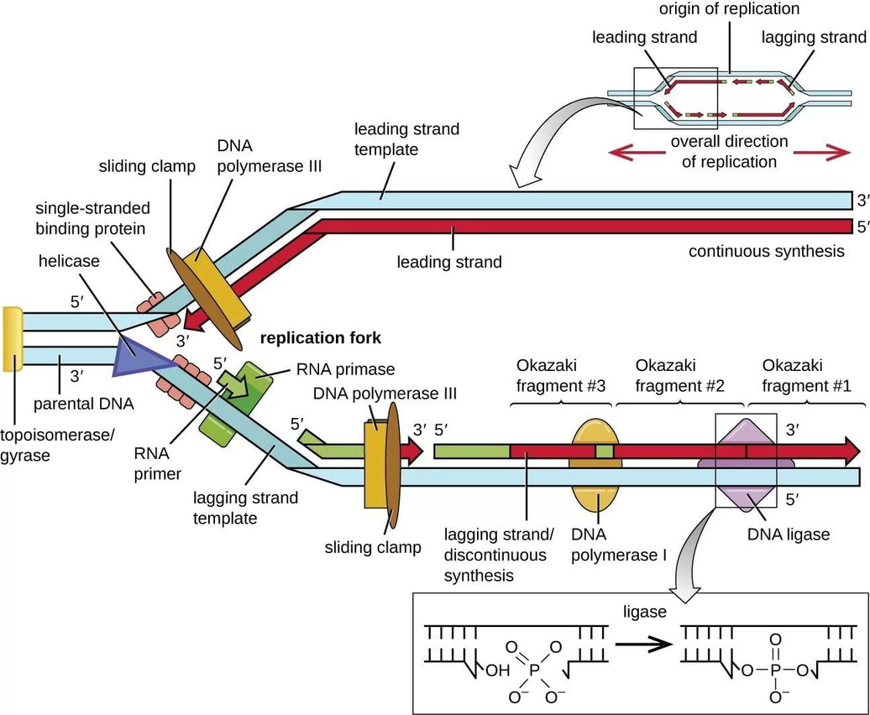
Components of Microbial DNA Replication Machinery
Helicase unwind the DNA strand
Primase mark the DNA where the plymerase start the replication
Polymerase III follows a 5' to 3' direction
Ligase Glue the okazaki fragment to became whole strand
DNA RTSP terminate the replication
Topoisomerase Segregation of chromosomes upon completion of DNA replication
Notes:
A second unusual feature is the directionality of strand synthesis. DNA polymerases can attach nucleotides only in the 5' to 3' direction, not in the 3' to 5' direction.
The two new DNA strands (namely, the leading and lagging strands) are synthesized in different ways.
In Leading Strand, synthesis of the daughter strand is continuous.
In Lagging Strand, synthesis of DNA occurs in short Okazaki Fragments.
An enzyme known as DNA ligase catalyzes a covalent bond between these adjacent DNA fragments to complete the process in the lagging strand.

Slide 14
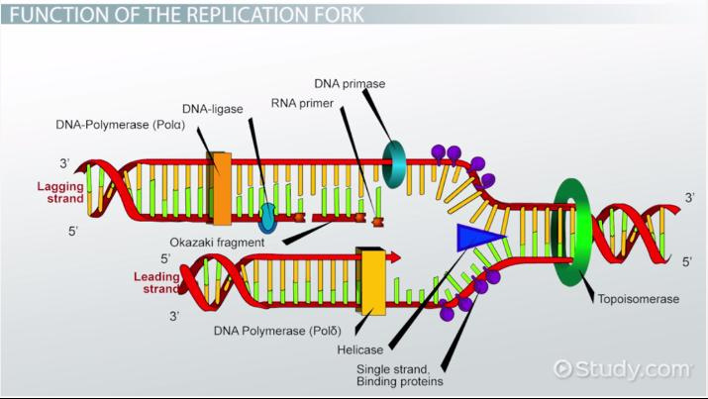
Components of Microbial DNA Replication Machinery
Helicase unwind the DNA strand
Primase mark the DNA where the plymerase start the replication
Polymerase III follows a 5' to 3' direction
Ligase Glue the okazaki fragment to became whole strand
DNA RTSP terminate the replication
Topoisomerase Segregation of chromosomes upon completion of DNA replication

Slide 15
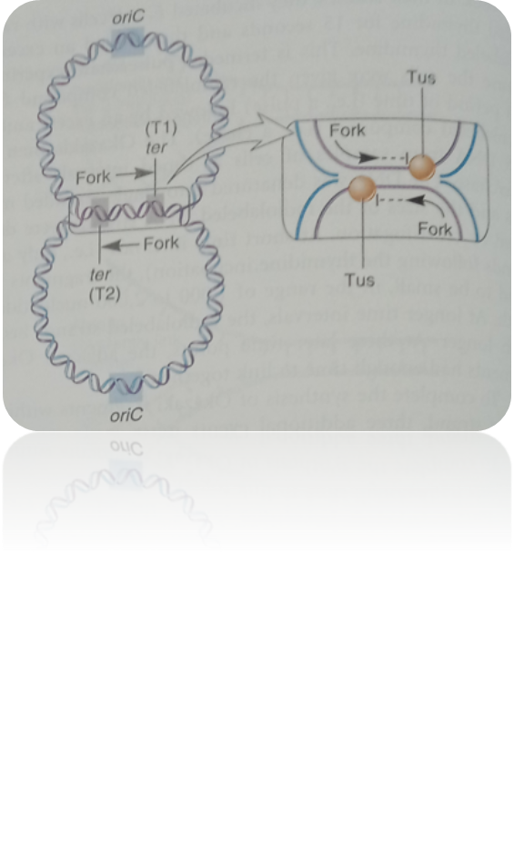
Replication Is Terminated When the Replication
Forks Meet at the Terminus Sequences
On the opposite side of the E. coli chromosome from oriC is a pair of termination sequences called ter sequences.
A protein known as the termination utilization substance (Tus) binds to the ter sequences and stops the movement of the replication forks.
DNA replication ends when oppositely advancing forks meet, usually at T1 or at T2.
Catenanes Interlocking circular DNA, Topoisomerase temporary break the DNA for the two DNA to be separated
Notes:
Interlocked circular molecules are known as catenanes. Topoisomerases introduce a temporary break into the DNA strands and then rejoin them after the strands have become unlocked. This allows the catenanes to be separated individual circular molecules.
The DNA replication exhibits a high degree of fidelity.
The hydrogen bonding between G and C or A and T is much mores stable than between mismatched pairs.
Proofreading function the ability to remove mismatched bases.

Slide 16
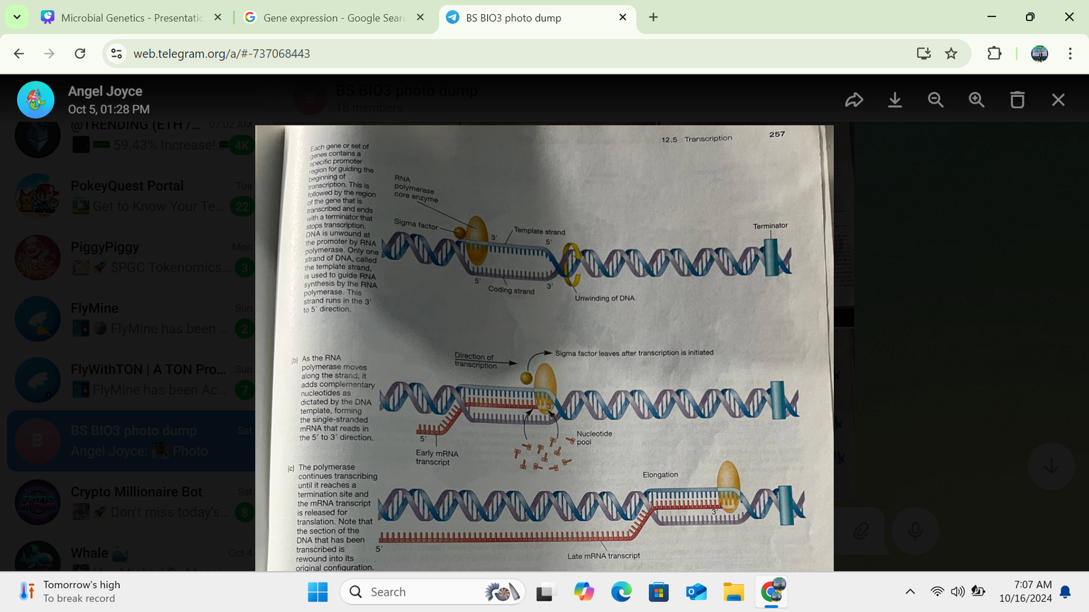
Gene Expression
DNA → RNA → Protein
Transcription is the process where a segment of DNA is copied into messenger RNA (mRNA).
Translation is the process where the mRNA is used as a template to build proteins.
EXPRESSION OVERVIEW
Microbial gene expression refers to the process by which bacteria transcribe and translate their genetic information (encoded in DNA) into functional proteins. The process is essential for bacteria to adapt to their environments and control the production of proteins needed for various cellular functions.

Slide 17
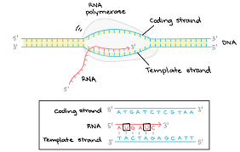
Transcription, as related to genomics, is the process of making an RNA copy of a gene's DNA sequence. This copy, called messenger RNA (mRNA), carries the gene's protein information encoded in DNA. It happens in three stages: initiation, elongation, and termination.
FROM DNA TO MRNA
Notes:
So in transcription Template strand is the one synthesize to produce mRNA with 3' to 5' direction rather than the coding strand with the aid of sigma factors an important protein guiding the RNA polymerase. Right after the RNA synthesis is terminated when the mRNA is release for transcription DNA rewind to original configuration.
Reminder that in Transcription thymine is substituted by Uracil.

Slide 18
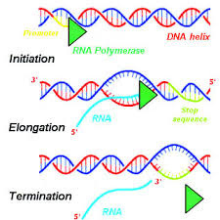
GENE EXPRESSION
Transcription
Initiation: RNA polymerase binds to the promoter (at -35 and -10 sequences). Once bound, it starts unwinding the DNA at the Pribnow box or TATA box (-10 site). The whole process takes place at the template strand or Antisense
Elongation: As the DNA unwinds it creates a Transcription bubbles , the RNA polymerase starts building the RNA strand by adding nucleotides in the 5' to 3' direction.
Termination: Once the RNA polymerase reaches the end of the gene, it stops transcription and releases the newly formed RNA strand. Termination takes place when RNA polymerase reaches the stop codon UAG UGA or UAA
Notes:
In transcription thee is Promoter region (Tata box) that marks the beggining of the RNA synthesis, Then the sigma factors guide the RNA polymerase for Reading direction. In higher biology there is the present of Clamp and rudder a protein enzymes help in guiding RNA polymerase. So the promoter region is usually not transcribed nor translated, since RNA should start with the start codon AUG

Slide 19
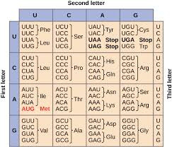
Gene Expression
Codon and their corresponding Amino acid

Slide 20
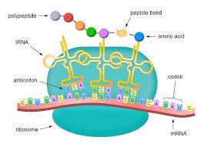
translation is the process in living cells in which proteins are produced using RNA molecules as templates. The generated protein is a sequence of amino acids. This sequence is determined by the sequence of nucleotides in the RNA. The nucleotides are considered three at a time.
FROM MRNA TO AMINO ACID CHAIN

Slide 21
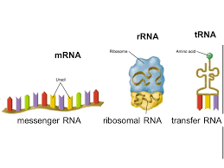
GENE EXPRESSION
Overview
1. Initiation:
Ribosome assembly at the start codon (AUG).
Binding of initiator tRNA carrying methionine.
2. Elongation:
Codon recognition, peptide bond formation, and translocation.
3. Termination:
Recognition of stop codon and release of the polypeptide.
Notes:
rRNA are responsible for reading the order of amino acids and linking amino acids together.

Slide 22
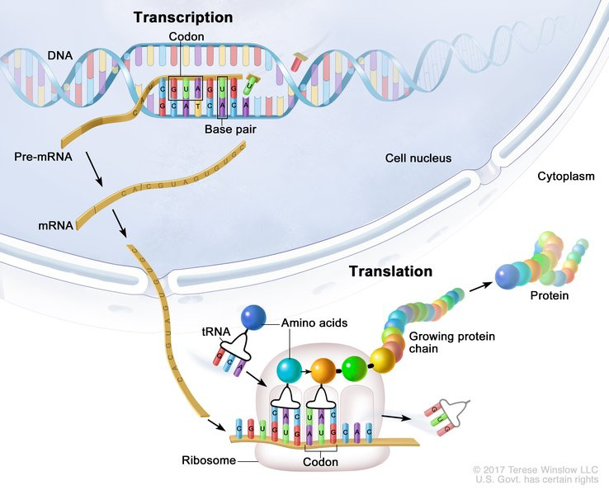
GENE EXPRESSION
Initiation
Ribosome Assembly:
The small ribosomal subunit binds to the mRNA near the start codon (AUG). In prokaryotes, the Shine-Dalgarno sequence helps align the ribosome, while in eukaryotes, the 5' cap structure is recognized.
Initiator tRNA Binding:
A special initiator tRNA carrying methionine (eukaryotes) or formylmethionine (prokaryotes) pairs with the start codon.
Joining of the Large Ribosomal Subunit:
The large subunit joins, completing the ribosome and positioning the initiator tRNA in the P-site.
Notes:
rRNA are responsible for reading the order of amino acids and linking amino acids together.

Slide 23
GENE EXPRESSION
Elongation
Codon Recognition:
The ribosome reads the mRNA one codon at a time. A tRNA with an anticodon complementary to the mRNA codon brings the corresponding amino acid into the A-site.
Peptide Bond Formation:
The ribosome catalyzes the formation of a peptide bond between the growing polypeptide chain in the P-site and the amino acid in the A-site.
Translocation:
The ribosome shifts three nucleotides down the mRNA, moving the tRNA with the growing polypeptide from the A-site to the P-site. The empty tRNA is then released from the E-site.
Notes:
rRNA are responsible for reading the order of amino acids and linking amino acids together.

Slide 24
GENE EXPRESSION
Termination
Recognition of Stop Codon:
When the ribosome encounters a stop codon (UAA, UAG, or UGA), there is no corresponding tRNA.
Release Factor Binding:
A release factor protein binds to the stop codon, triggering the release of the completed polypeptide from the tRNA in the P-site.
Ribosome Disassembly:
The ribosomal subunits separate, and the mRNA is released, ready for another round of translation or degradation.
Notes:
rRNA are responsible for reading the order of amino acids and linking amino acids together.

Slide 25



THANK YOU
Presentation by Jheyrick Baliguat
Microbiology
BS Biology 4

Slide 26
Additional Readings
https://docs.google.com/document/d/1AWtFvrANVmCsn7XxR44yqyAzmwg-9B-erxkZ6JHeBkQ/edit?usp=sharing
Microbiology
BS Biology 4

Slide 27
Replication and transcription of Bases
Parental Strand | Daughter strand (Replication) | Transcription (mRNA) | Amino acid chain
A T G T A C C A A G T T C G A | T A C A T G G T T C A A G C T | A U G U A C C A A G U U C G U | Met Tyr Gin Val Arg
Microbiology
BS Biology 4

